Slide 1
Plate Tectonics

Slide 2
By the end of this lesson, you should be able to:
Outline the theory of plate tectonics.
Explain how mantle convection drives plate tectonics.
Identify the major plates on a world map.
Identify sources of heat inside the Earth.
Discuss how this theory explains the movement of continents and oceans.

Slide 3
It took another 50 years for other scientists to believe Wegener’s theory of continental drift.
A man named Harry Hess observed the seafloor using sonar. Hess noticed mid-ocean ridges, (underwater mountain ranges). With this new information, he came up with the theory of seafloor-spreading—where the seafloor expands and more new crust is added.
With this new information, Hess was able to build on Wegener's theory of continental drift and create the modern theory of plate tectonics.

Slide 4
Remember that the lithosphere comprises the Earth’s crust and the top part of the mantle. The lithosphere is broken up into large, rocky sections known as tectonic plates.
These plates are made of either continental crust or oceanic crust. These helpful names are pretty self-explanatory.
Continental crust is the thicker part of the crust that makes up all the land on Earth, as well as the continental shelves.
Oceanic crust is thinner and found under oceans and seas. It is also younger and denser than continental crust.

Slide 5
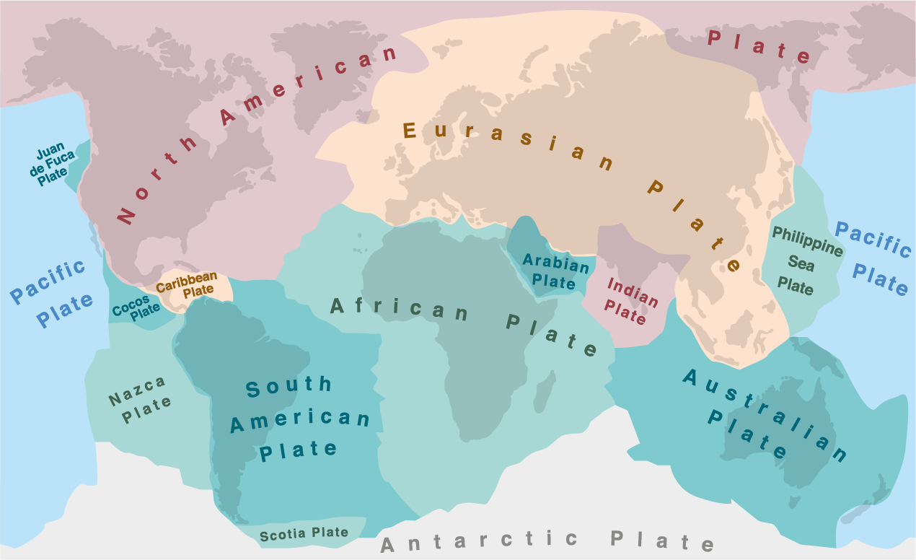
There are a lot of tectonic plates, but many are very small and often not included on tectonic plate maps.
Some major tectonic plates are the Pacific Plate, the North American Plate, the Eurasian Plate, the African Plate, the Antarctic plate, the South American Plate, the Australian Plate and the Indian Plate.

Slide 6
Underneath the lithosphere is the asthenosphere.
The asthenosphere is made of rocks that are so hot that they have become soft. These rocks are soft enough that they are able to move, but very slowly. This slow movement is caused by a process called convection; we will learn more about this in the next section.
The rigid lithosphere is able to float on the asthenosphere. Therefore, as the asthenosphere slowly moves, the lithosphere and its tectonic plates move along with it. This is what causes continental drift—finally, we have a mechanism for Wegener’s theory.

Slide 7
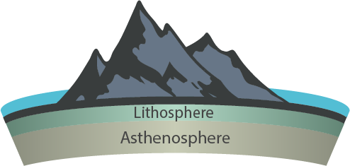

Slide 8
The asthenosphere can move because of a process called convection.

Slide 9
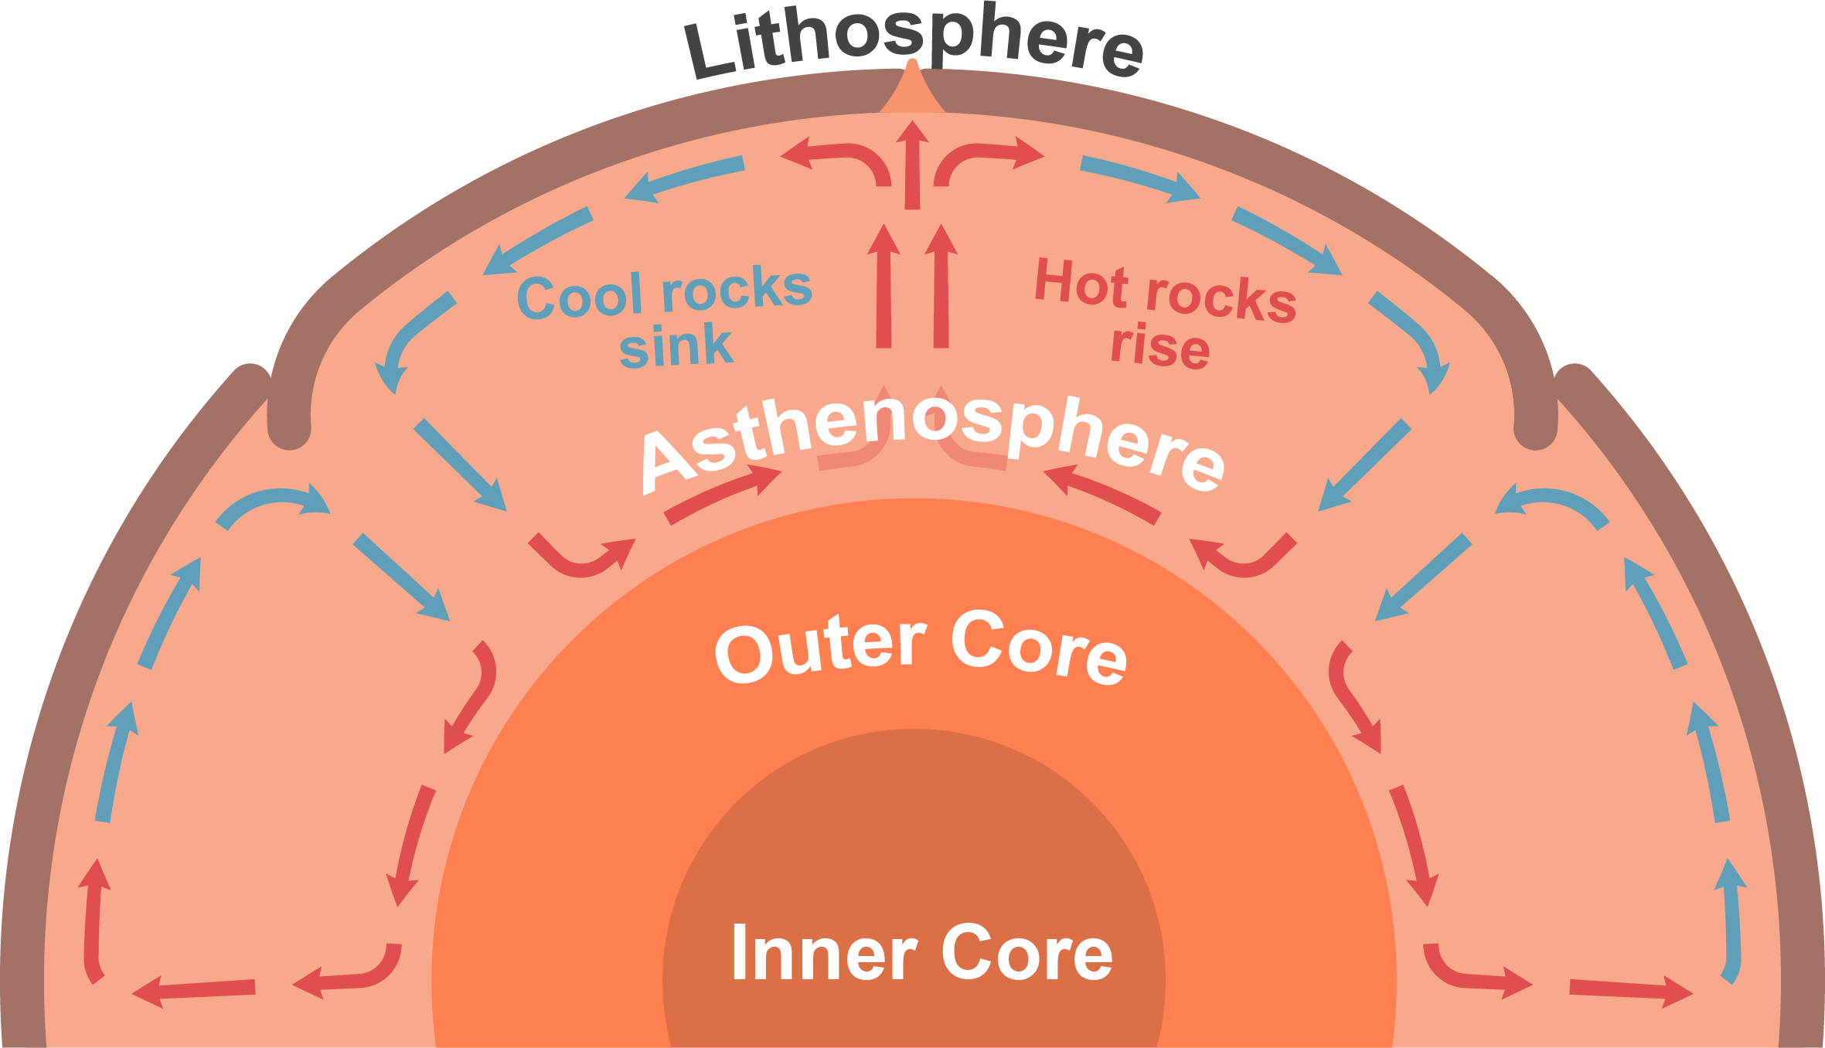
Rocks in the Earth’s asthenosphere undergo a very slow type of convection.
The Earth is coolest at the crust and hottest at the core. Therefore, the mantle nearest the core is heated and very slowly rises towards the crust where it cools. As the rocks cool they are pushed to the side by more rock rising underneath them and they sink back toward the core to be heated again.

Slide 10
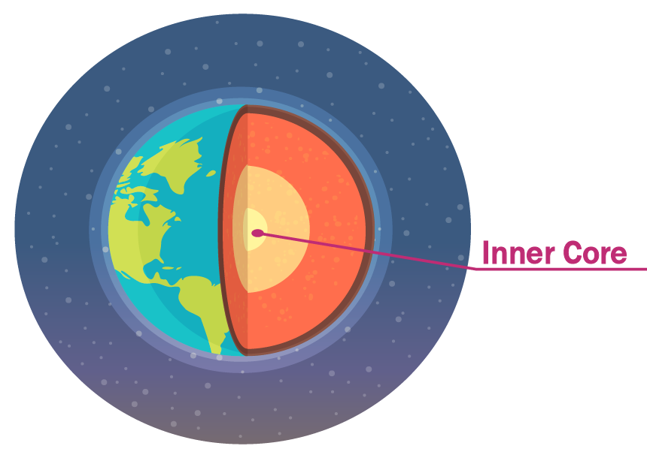
We still have one important question left to answer to explain plate tectonics: How is the asthenosphere heated?
We know that the asthenosphere is hot—really hot. So hot that the rocks that it's made of become soft enough to move. This is because the inner core of the Earth is thousands of degrees hotter than the surface.

